Slide 1
UDACITY: CLOUD DEVELOPER
AUTHOR: DIEN VO
DATE: 27 AUG 2O23

Slide 2
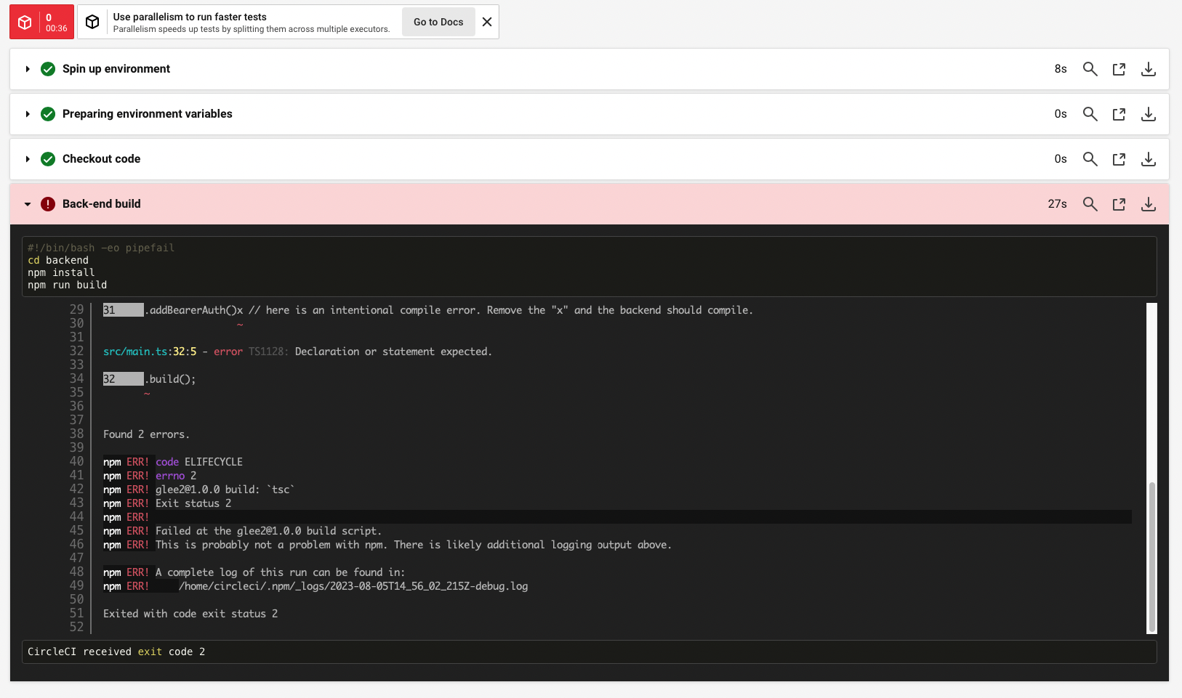
Job failed because of compile errors
http://54.89.88.16:3030

Slide 3
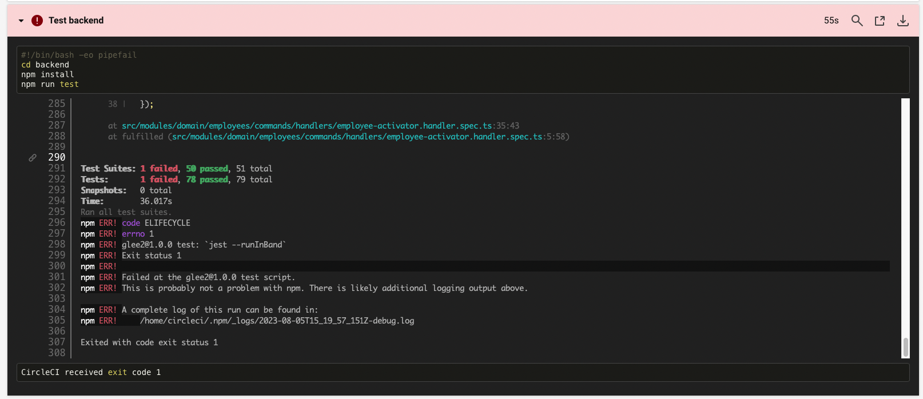
Job failed because of unit tests
http://54.89.88.16:3030

Slide 4
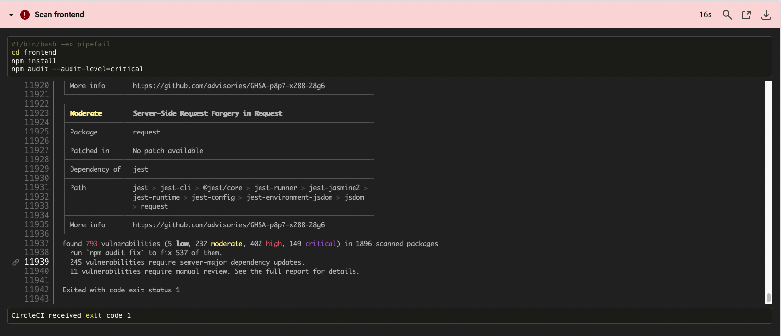
Job that failed because of vulnerable packages
http://54.89.88.16:3030

Slide 5
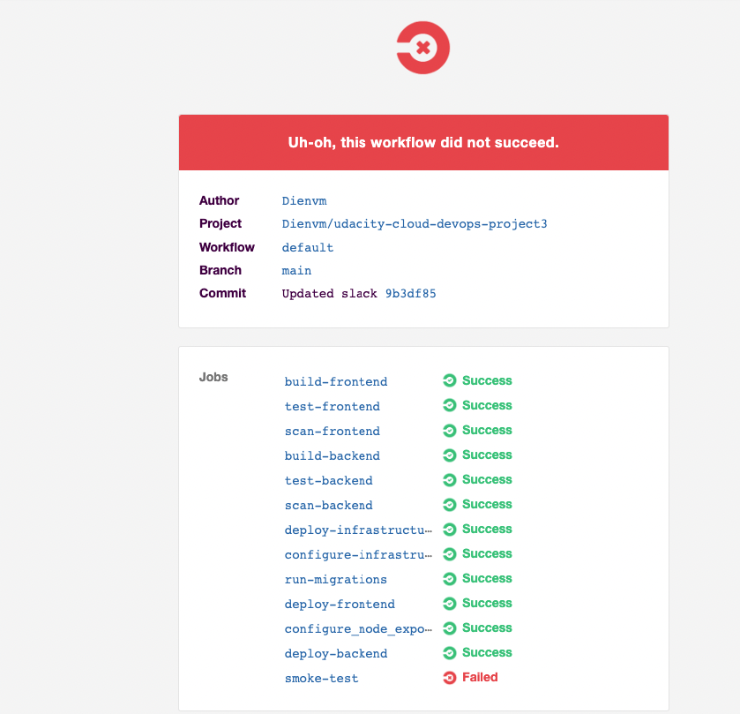
An alert from one of your failed builds

Slide 6
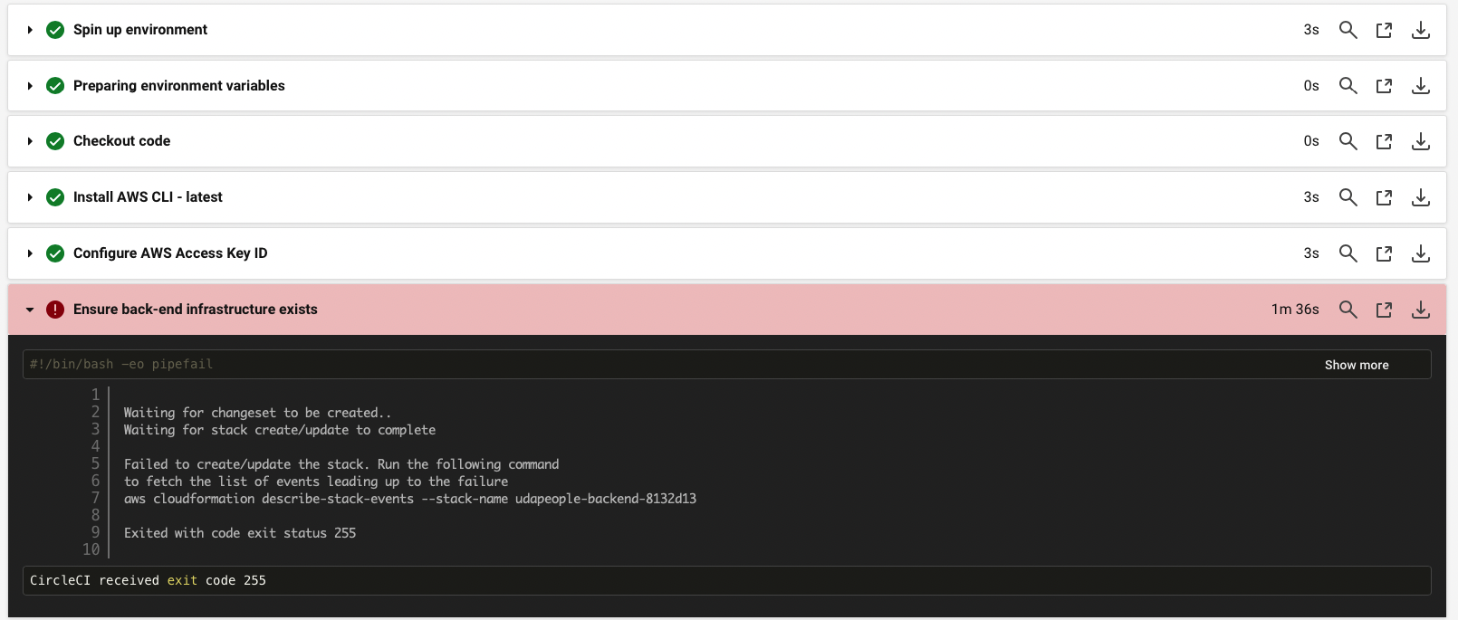
Appropriate job failure for infrastructure creation

Slide 7
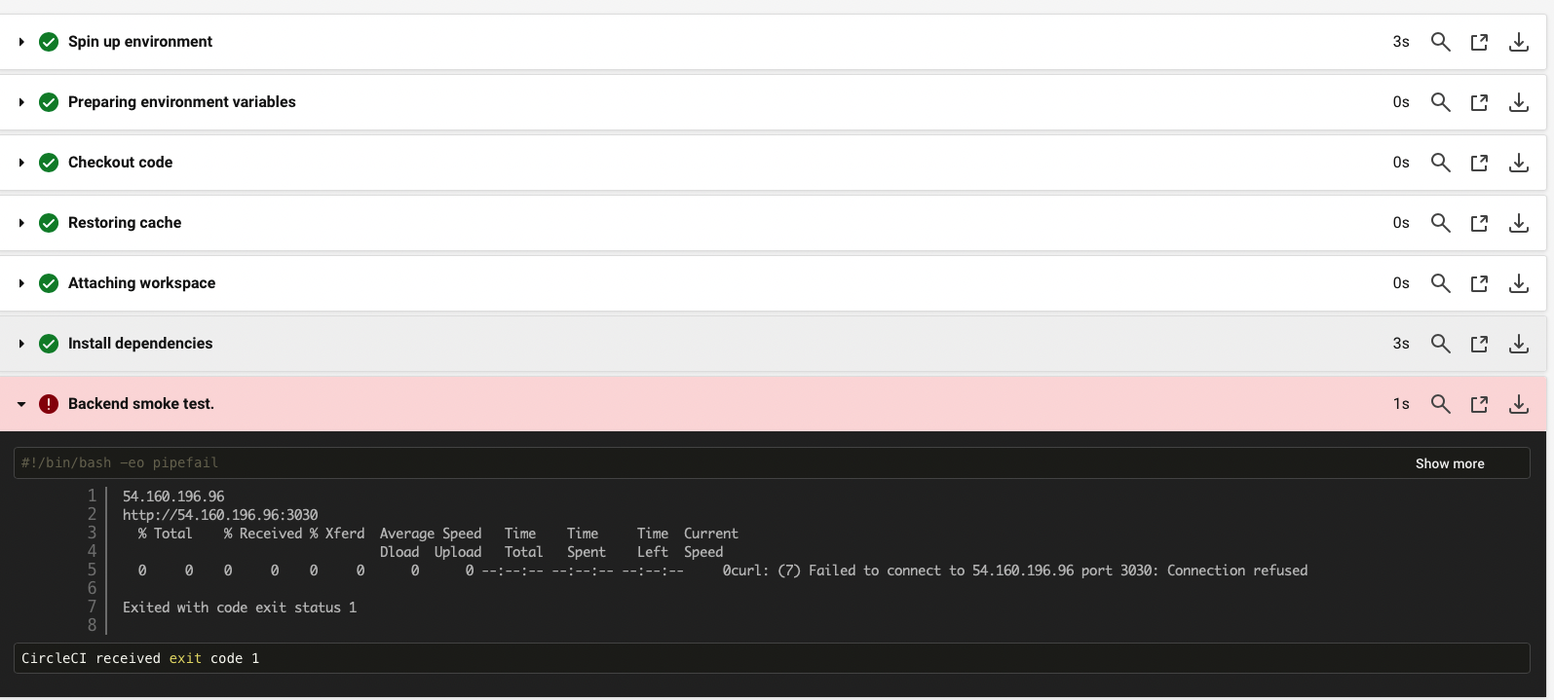
Appropriate job failure for the smoke test job.

Slide 8
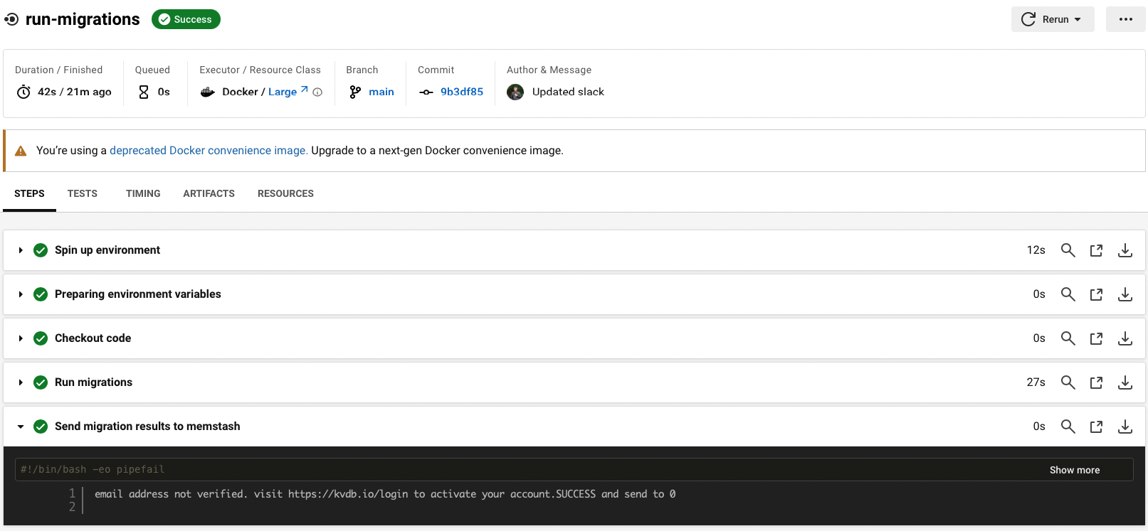
Successful rollback after a failed smoke test

Slide 9
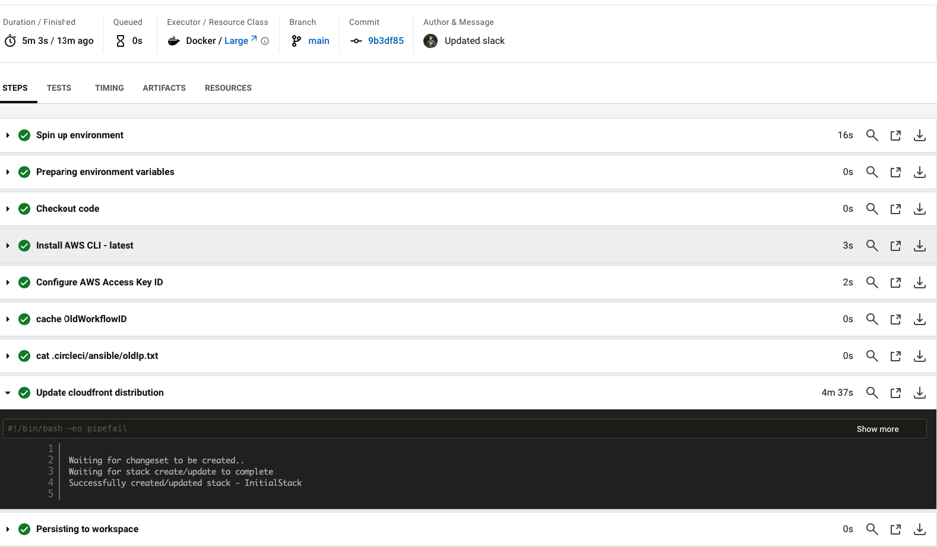
Successful promotion job

Slide 10
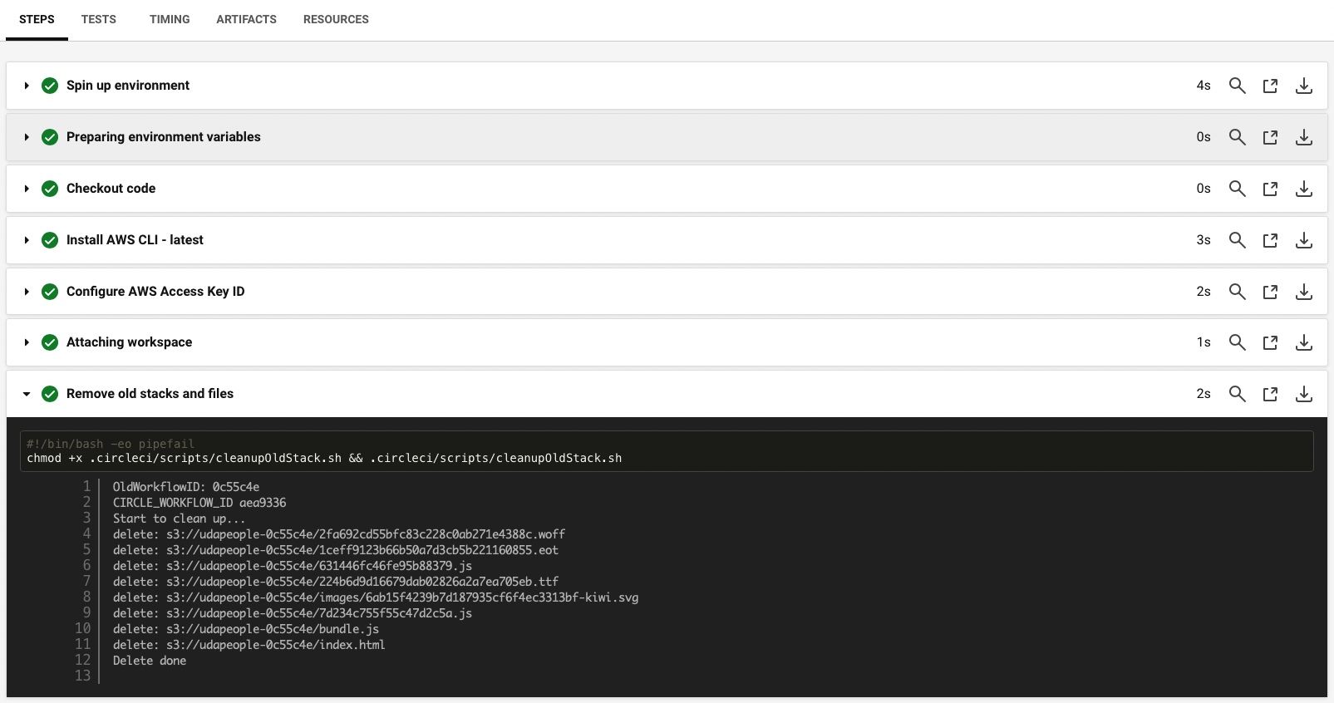
Successful cleanup job

Slide 11
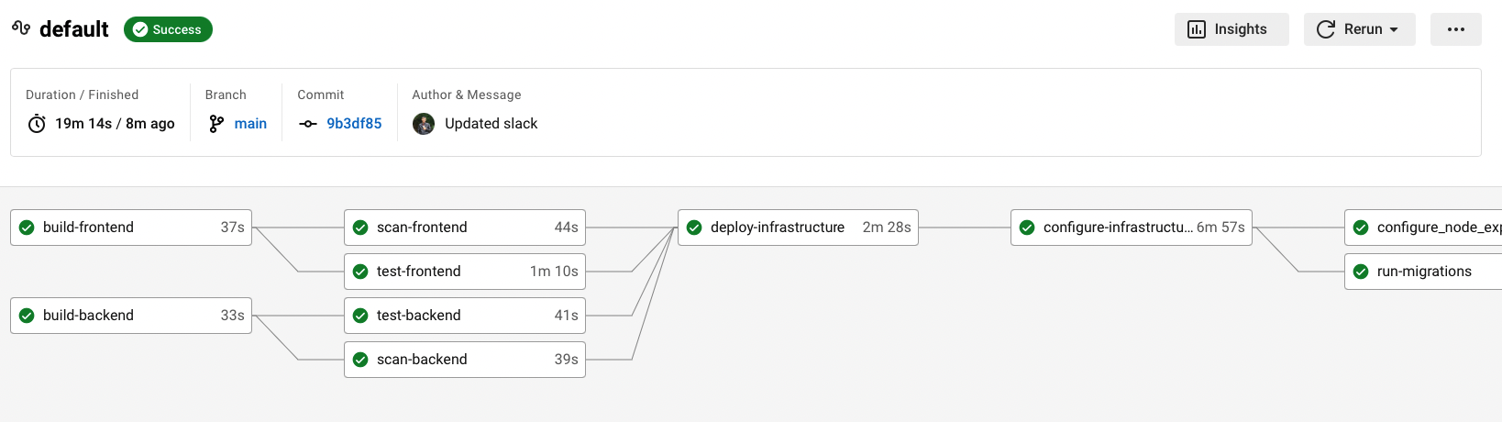
Only deploy on pushed to main branch

Slide 12
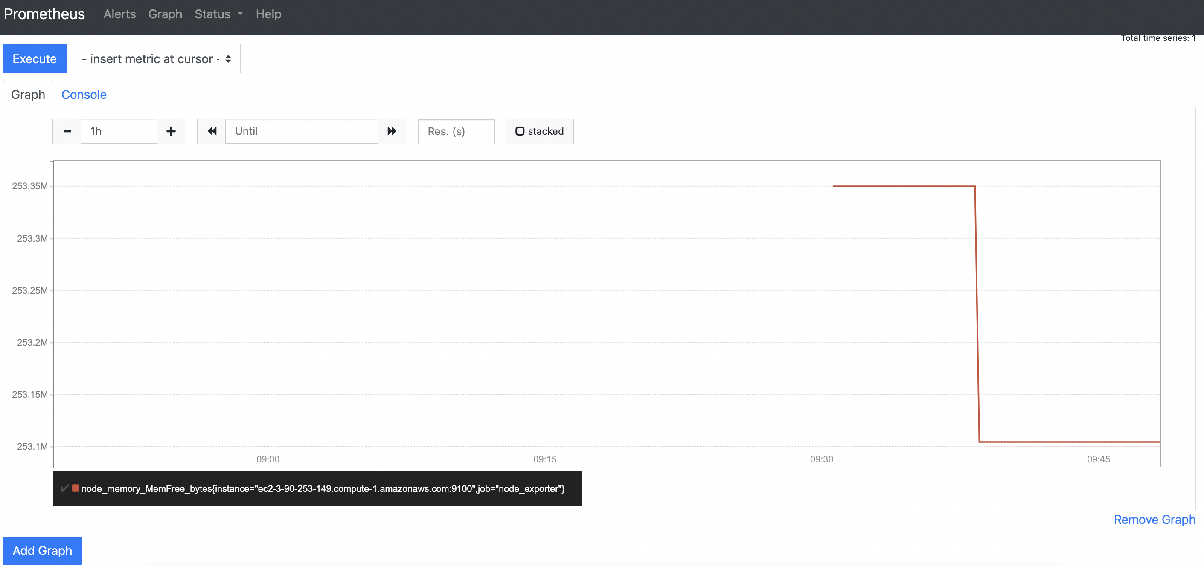
Provide a screenshot of a graph of your EC2 instance including available memory, available disk space, and CPU usage

Slide 13
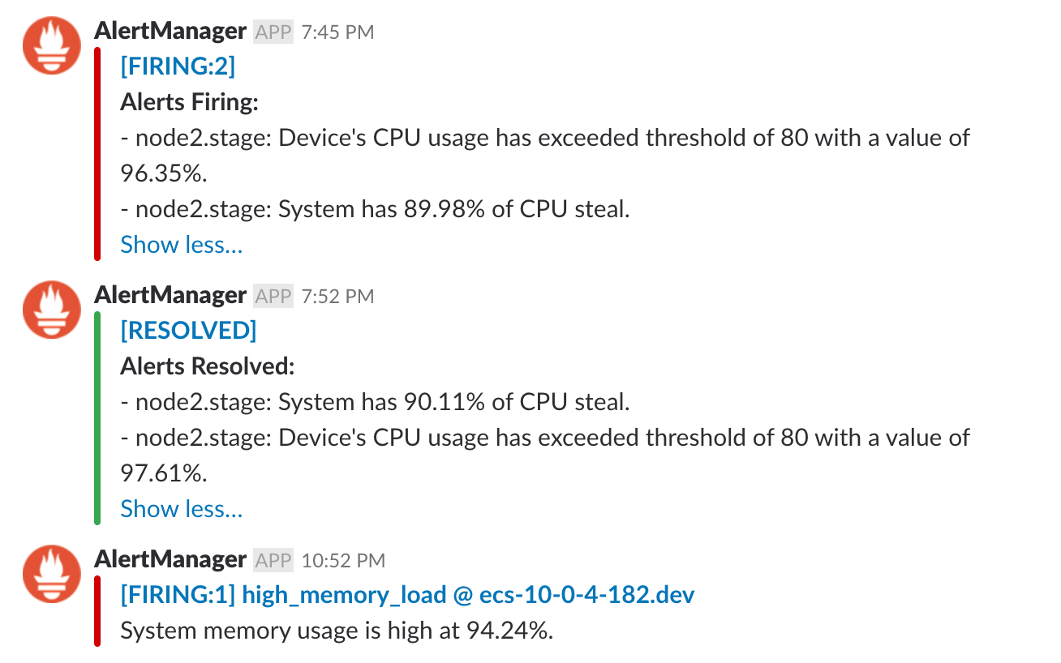
Provide a screenshot of an alert that was sent by Prometheus

Slide 14
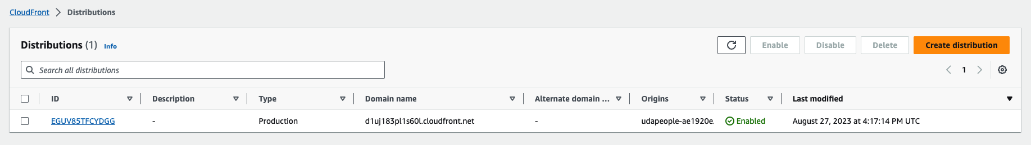
Application in CloudFront

Slide 15
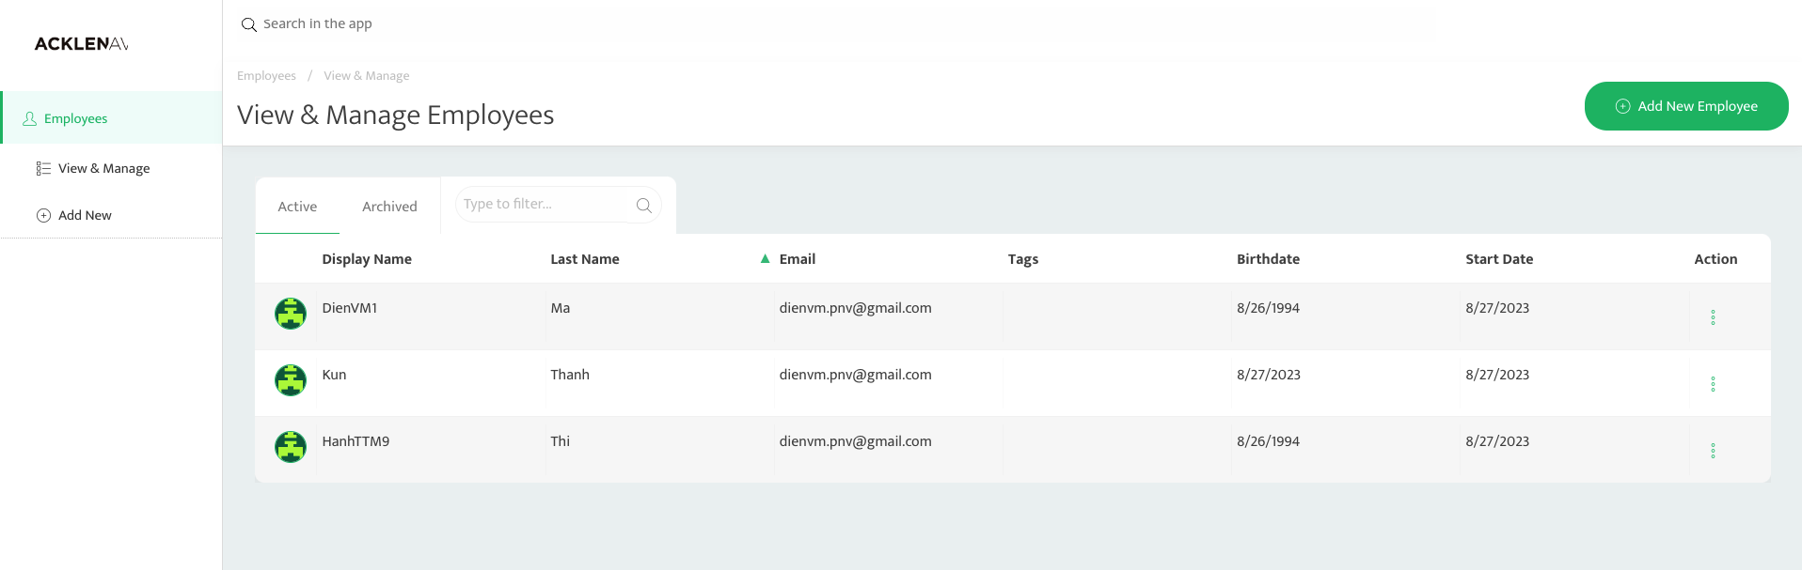
Application

Slide 16
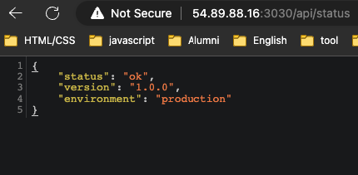
The backend endpoint status

Slide 17
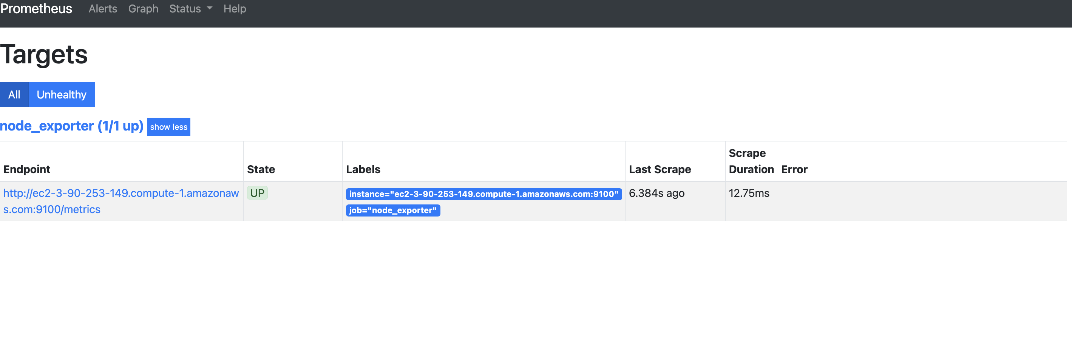
Prometheus server showing UP state

